Slide 1
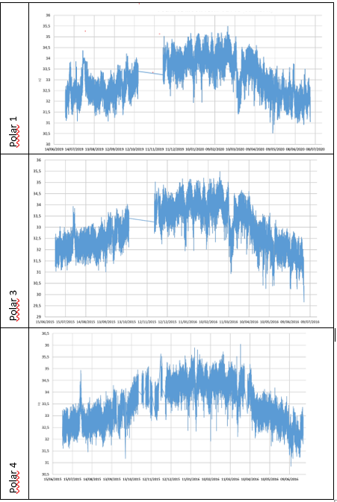
Seasonal variation of muon flux
Liceo Scientifico Cavour Roma, Italy
Who are you?
Carmen Mocanita for highschool «Liceo Scientifico C.Cavour» (Rome)
EEE-ICD event https://agenda.centrofermi.it/event/174/ : 380 participants
What have you done?
What did you find out?
I’ve found out that (from all the detectors):
The mean rate is 33,16 Hz
The maximum flux is 35,68 Hz (in the 28/02/20)
The minimum flux is 30,01 Hz (05/05/20-30/06/20)
I’ve noticed a seasonal variation of the muon’s flux. There is an increase in winter and a lowering in summer.
We had to do our analysis of the muon rate from July 2019 to July 2020. We analysed the data from the POLA-01, POLA-03 and POLA-04.
We used Excel (transforming the time value into a date and correcting the rate values for the barometric effect) and made some graphs. Then we calculated some numerical values and observed the graphs.
What's your take-home message?
The muon flux depends on the air pressure.

